Slide 1
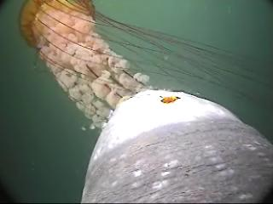


Mapping the distribution of Dermochelys coriacea by proxy: A method to quantify surface aggregations of Chrysaora fuscescens and Aurelia Spp.
Photo : Bill Watson
Erin E. Frolli
Lisa A. Webb Scott R. Benson
Notes:
Today I will be discussing my undergraduate research project at Cal State Monterey Bay and I would like to acknowledge my coauthors, Lisa Webb at Moss Landing Marine Labs and Scott Benson of Protected Resources Division at the Southwest Fisheries Science Center.
And what you are seeing here is a leatherback turtle eating a brown sea nettle but more of that is to come.

Slide 2
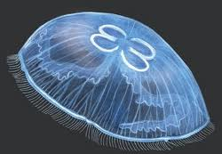
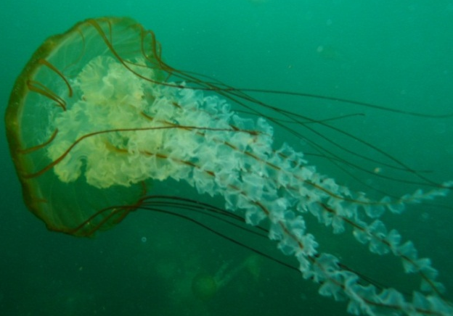
Most Common Jellies
Introduction
animaldiversity.ummz.umich.edu
Moon Jelly
(Aurelia spp.)
Brown Sea Nettle (Chrysaora fuscescens)
Notes:
Jellies have long since been thought of as nescience.
Jellies aggregate near fish schools thus are often caught in nets and wrapped around fishing lines, making them common bycatch organisms.
Jellies are also known for breaking fishing nets and sea water uptake valve screens due to their dense bodies being 95% water (Calton and Burnett 1973).
Jellies have recently been found to be good indicators of harmful algal blooms.
Leatherbacks are most often seen in Monterey Bay in late summer and early fall feasting on the jellies a the height of their blooms.
We examined two species of jellies moon jellies and brown sea nettle
Both are the most common and most abundant large medusae in the US west coast are known to be part of the leatherback diet
A Tanya Graham, graduate student at Moss Landing Marine Labs, developed a method to quantify jellies using aqustic sonar. Due to the orientation of the equipment it is blind to the upper five meters. And based on leatherback dive data we know that leatherback forage on jellies with in the first 5 m of water (Benson et al. 2007)

Slide 3
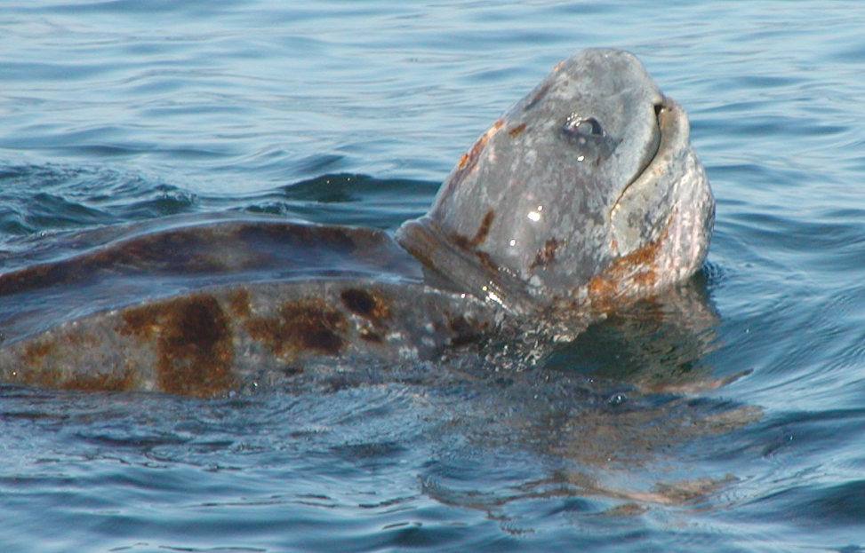
Western Pacific Leatherback (Dermochelys coriacea)
Introduction
Migrate from Indonesia to foraging grounds in US West Coast
Endangered 1970
Critically endangered 2006
Critical habitat established 1979
2009 revised foraging grounds in U.S. (Benson et al. 2007)
Photo:Scott Benson
(NOAA Fisheries 2010)
Notes:
Western Pacific leatherback turtles are the largest turtle and largest living reptile. (WWW.nmfs.noaa.gov/pr/species/turtles/leatherback.htm)
This species was listed endangered throughout its range by the US Endangered Species Act in 1970 and was listed the critically endangered under the World Conservation Union Red list in 2006. (Graham 2009_thesis)
The leatherback turtles migrate across the Pacific from nesting grounds in Indonesia to forage on scyphozoan jellies in US west coast waters.
The primary prey for Leatherbacks are large jellies (WWW.nmfs.noaa.gov/pr/species/turtles/leatherback.htm)
In 1979 critical habitat was established for this leatherbacks for nesting beaches in Saint Croy on the US Virgin Islands and in 2009 revision to the critical habitat designation was proposed to include U.S. West Coast as a foraging ground because of the dense aggregations of jellies (Benson et al. 2007, NOAA Fisheries 2010). This is the first proposal of its kind.

Slide 4
Introduction
Our Goal
To develop a inexpensive, efficient method to quantify surface aggregations of large medusae to help define critical foraging habitat for leatherback in U.S. West Coast waters
Notes:
Our goal was to develop a inexpensive , efficient method to quantify surface aggregations of large medusae to help define critical foraging habitat for leatherback in U.S. West Coast Waters
The availability of dense jellies aggregations is being used to assess the proposal for revision of critical habitat for leatherbacks on the US. West Coast
Currently observers assign a qualitative scoring index of jelly density
There is a need to quantify counts for observers estimates
For assessment of critical habitat there is a need to obtain jelly estimates

Slide 5
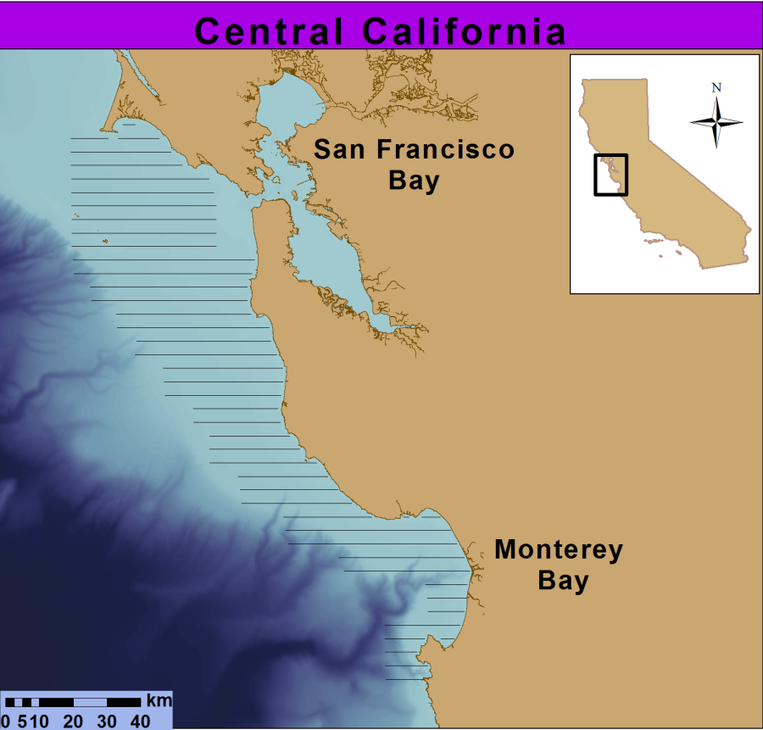
Study Area
Introduction
Central California
High densities of leatherbacks and jellies
Fine scale lines for aerial surveys
Notes:
the study area that comprises of the highest densities of leatherback however turtles have been observed along the California coast (Benson et al. 2007)
This area is subjected to extreme oceanographic variability due to upwelling events
The aerial transect lines shown are lines over neritic habitat which is less then 100m in depth and where most jellies are located.
These survey lines are used to assess the distribution and abundance of leatherback turtles

Slide 6
Study Area
Introduction
Central California
High densities of leatherbacks and jellies
Fine scale lines for aerial surveys
Notes:
the study area that comprises of the highest densities of leatherback however turtles have been observed along the California coast (Benson et al. 2007)
This area is subjected to extreme oceanographic variability due to upwelling events
The aerial transect lines shown are lines over neritic habitat which is less then 100m in depth and where most jellies are located.
These survey lines are used to assess the distribution and abundance of leatherback turtles

Slide 7
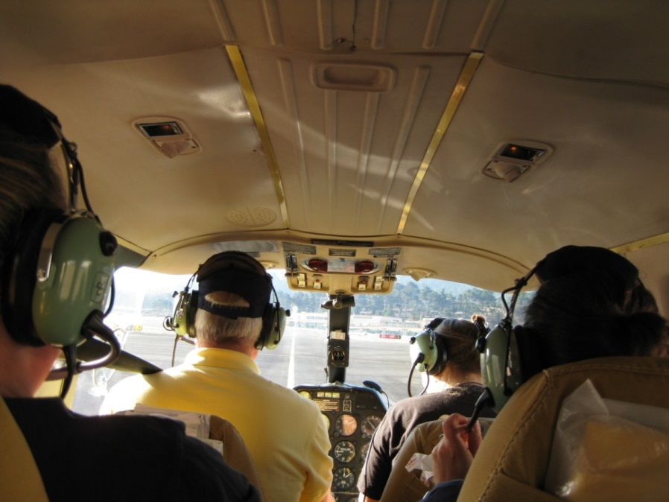

Methods
Aerial Surveys
Data Processing
3 observers: qualitative index
31 photos: quantitative score
Notes:
Our methods contained two parts.
First aerial surveys were conducted to obtain photos of jelly aggregations
Second 30 photos were processed for two common species of large meduse brown sea nettle and moon jellies

Slide 8
Aerial Survey Methods
Methods
Aerial transects conducted in October 2010
Plane height during transects was 198m with a speed of 90-100 knots as previously described in Forney et al. 1991 and Benson et al. 2007
Notes:
Aerial line-transect surveys were conducted for three consecutive days in October 2010 to examine leatherback turtle distribution and abundance off central California
All transects were conducted using three person observer team in a twin engine fix wing following methods described in Forney et al. 1991 and Benson et al. 2007.

Slide 9
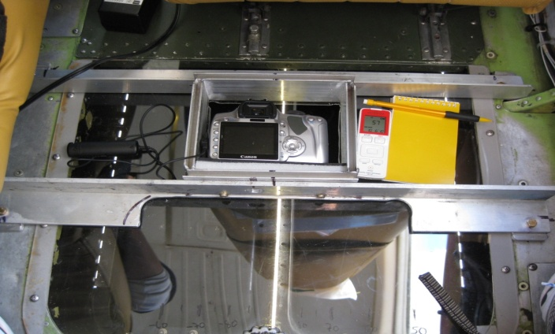
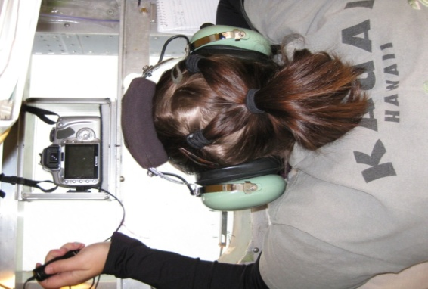
Methods: Aerial Survey
Custom camera mount with shutter release
10 megapixel digital still camera
Camera lens 51mm
Depth range into water for both photos and observers is 1m
Belly observer with camera
Notes:
Jelly densities within the strip-transect beneath the plane were continuously assessed by all three observers who came to a consensus and assigned a categorical index of relative density: no jellies, low (1-30), moderate (31-300), or high (> 301)
During Aerial transects a 10 megapixel digital still camera was custom mounted in the belly window to allow opportunistic photographs of jelly aggregations
Camera was mounted face down in order to capture the transect line directly underneath the plane.
The camera lens was set to 55mm capture what is seen by the human eye.
The depth range for both the photos and the observer is from the sea surface to approximately 1 m depth depending on water clarity and glare.

Slide 10


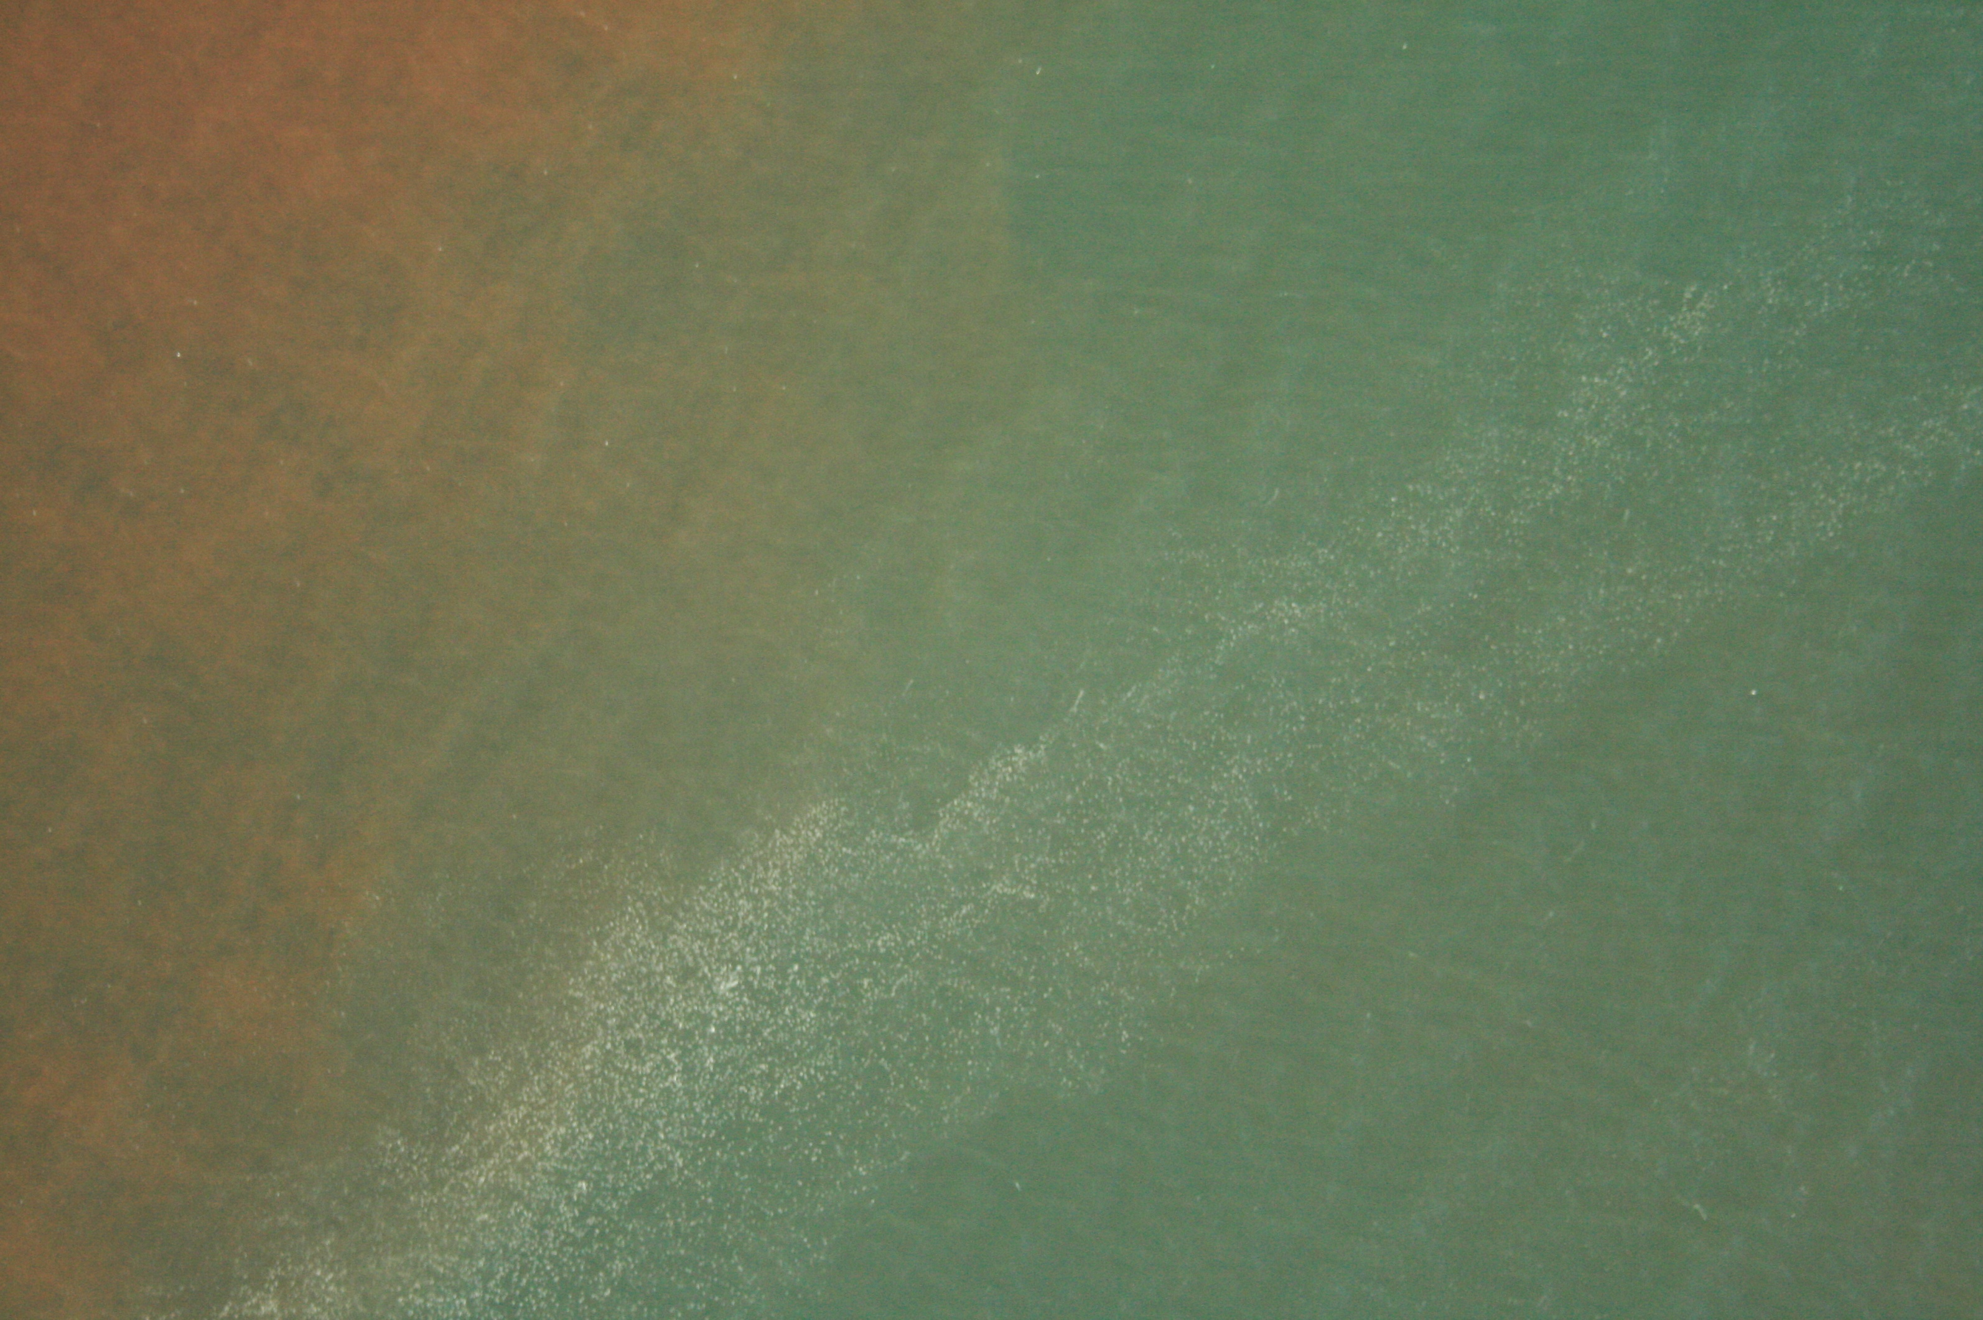
Photograph Categorization
Methods: Data Processing
Low
(1-30)
Moderate
(31-300)
High
(>301)
Notes:
15 photographs of each species was chosen for enumeration for a total of 30 photos
GPS data was then used to minimize spatial and temporal autocorrelation when choosing the photos
Water color varies based on lighting, glare, red tide or other oceanographic conditions

Slide 11
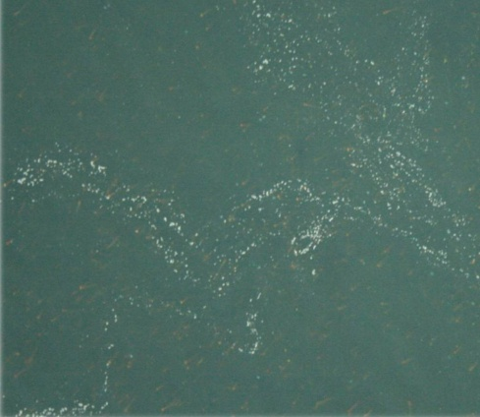
Methods: Data Processing
Original Photograph
Notes:
The number of jellies in surface waters for each photograph was determined using two methods:
The first method being the manual count using ArcGIS and as second method being an automated count using a custom Matlab algorithm

Slide 12
Methods: Data Processing
Original Photograph
Manual Count: Processed with ArcGIS
Notes:
The first method being the manual count using ArcGIS

Slide 13
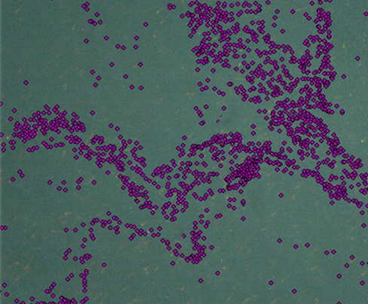
Methods: Data Processing
Manual Count: Processed with ArcGIS
Notes:
The for the first method each photograph was imported into ArcGIS and a point feature database was created
The photograph was enlarged and each moon jelly was hand-marked as a point (purple dots above)
Assuming the manual count is a proxy for the actual number of jellies in the photo the
Total number of jellies = total number of points
Because the fist photo had over 8,000 jellies in it and it took me over 2 hours to count individuals we decided that an automated method was needed

Slide 14
Methods: Data Processing
Original Photograph
Manual Count: Processed with ArcGIS
Automated Count: Processed with MatLab
Notes:
Because the fist photo had over 8,000 jellies in it and it took me over 2 hours to count individuals we decided that an automated method was needed
Which I will walk you through next

Slide 15
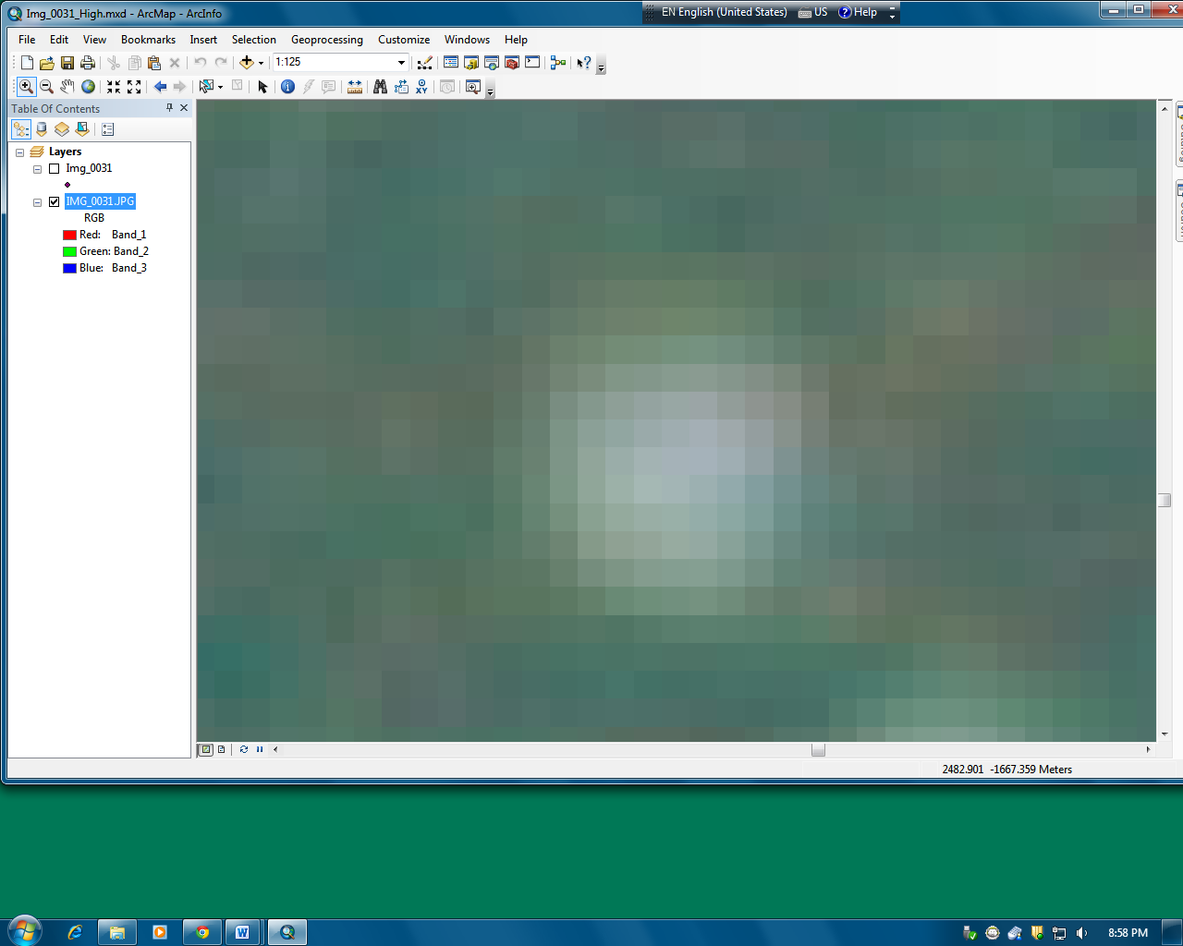

Automated Detection Algorithm : MatLab
Methods: Data Processing
Notes:
First to asses the size of individual jellies. 100 randomly selected jellies were chosen to obtain the bell surface area in pixels

Slide 16
Automated Detection Algorithm : MatLab
Methods: Data Processing
Notes:
First to asses the size of individual jellies. 100 randomly selected jellies were chosen to obtain the bell surface area in pixels

Slide 17
Automated Detection Algorithm : MatLab
Methods: Data Processing
Notes:
First to asses the size of individual jellies. 100 randomly selected jellies were chosen to obtain the bell surface area in pixels

Slide 18
Automated Detection Algorithm : MatLab
Methods: Data Processing
Max RGB Values
Min RGB Values
Notes:
Since the algorithm is based on color range of each species
Individual jellies within the photo were chosen to define the color range and with was calibrated for water color, depth, and glare
Pixels containing red, green, and blue values and from now on I will referring to as RGB
The maximum and minimum RGB values were then used to define the specific color range for jellies in each photo.

Slide 19
Automated Detection Algorithm : MatLab
Methods: Data Processing
Max RGB Values
Min RGB Values
Notes:
The algorithm then searched every pixel within the photo and looked for the range specified then counted and tagged the pixels with a bright blue color indicator

Slide 20
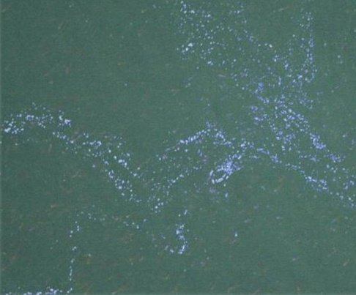
Automated Detection Algorithm : MatLab
Methods: Data Processing
Max RGB Values
Min RGB Values
Notes:
When completed the algorithm produced the total number of tagged pixels within the photo
Total number of jellies =number of colored pixels/mean surface area of a jelly in pixels

Slide 21
Automated Detection Algorithm : MatLab
Methods: Data Processing
Max RGB Values
Min RGB Values
Total number
of colored pixels
Notes:
When completed the algorithm produced the total number of tagged pixels within the photo
Total number of jellies =number of colored pixels/mean surface area of a jelly in pixels

Slide 22
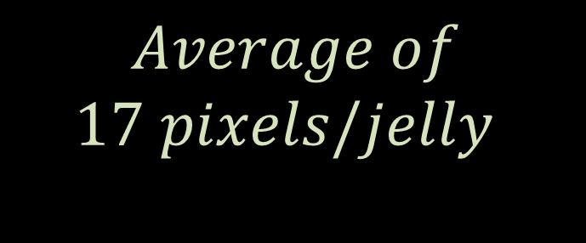
Automated Detection Algorithm : MatLab
Methods: Data Processing
$$Average of \\ 17 pixels/jelly$$
Notes:
First to asses the size of individual jellies. 100 randomly selected jellies were chosen to obtain the bell surface area in pixels

Slide 23

Automated Detection Algorithm : MatLab
Methods: Data Processing
$$Total Jellies= \frac{50,589pixels}{photo} ∗ \frac{jelly}{17 pixels}$$
Notes:
First to asses the size of individual jellies. 100 randomly selected jellies were chosen to obtain the bell surface area in pixels

Slide 24
Automated Detection Algorithm : MatLab
Methods: Data Processing
Max RGB Values
Min RGB Values
Surface area
In pixels
Total number
of jellies/photo
Total number
of colored pixels
Notes:
When completed the algorithm produced the total number of tagged pixels within the photo
Total number of jellies =number of colored pixels/mean surface area of a jelly in pixels

Slide 25
Methods: Data Processing
Original Photograph
Manual Count: Processed with ArcGIS
Automated Count: Processed with MatLab
Notes:
Total time processing with ArcGIS was a minimum of 3 hours per photo
Total time processing with MatLab was a average of 15 minutes per photo

Slide 26
Does it work?
To understand the algorithms accuracy, we compared the automated method to that of the manual count
Notes:
I will be continuing to apply this method to the remaining photos from October 2010 and October 2011. The new estimates of the density categories will be able to help researchers understand the relative magnitude of jellies seen on a given survey year relative to oceanographic conditions and if there is a trend.
I will use the GPS data that was recorded during transects to build density maps. These maps that will allow us to see were turtles have been found in relation to the jelly aggregations. The maps will also be helpful in locating hot spots or high jelly density aggregations that may be detrimental to fishing efforts and sea water uptake valves. These hot spots can also be predictors of leatherbacks in the future.

Slide 27
Results
Manual Count: Processed with ArcGIS
Automated Count: Processed with MatLab
VS
Total individuals 15,767
Total individuals 11,941
Notes:
As you can see on the right the manual count was 15767 and the automated count was 11941 so pretty good estimate
Simple linier regressions were used to determine the relationship by comparing the manual count to the automated count.

Slide 28
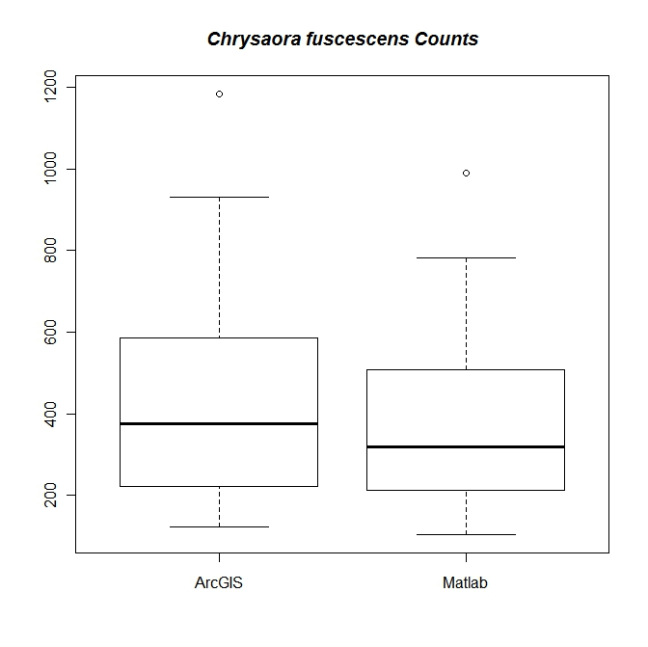
Brown Sea Nettle
Results: Student’s T-Test
N=16
No statistical significance between the two methods
Notes:
Across the x-axis we see the ArcGIS manual count and on the Y-axis we see the automated matlab jelly count
If the automated program was perfect detecting every jelly in the photo we would see the 1-1 dotted line.
For our data the solid line we see that the algorithm underestimates especially when aggregations are high. This is due to the shape of the brown sea nettles, the sea nettles are most often seen horizontal in the water columns so that both bell and oral arms are seen. This hinders the algorithm’s ability to detect the full jelly because the oral arms may over lap causing the algorithm not able to detect individuals.

Slide 29
Brown Sea Nettle
Results: Student’s T-Test
N=16
Notes:
Across the x-axis we see the ArcGIS manual count and on the Y-axis we see the automated matlab jelly count
If the automated program was perfect detecting every jelly in the photo we would see the 1-1 dotted line.
For our data the solid line we see that the algorithm underestimates especially when aggregations are high. This is due to the shape of the brown sea nettles, the sea nettles are most often seen horizontal in the water columns so that both bell and oral arms are seen. This hinders the algorithm’s ability to detect the full jelly because the oral arms may over lap causing the algorithm not able to detect individuals.

Slide 30
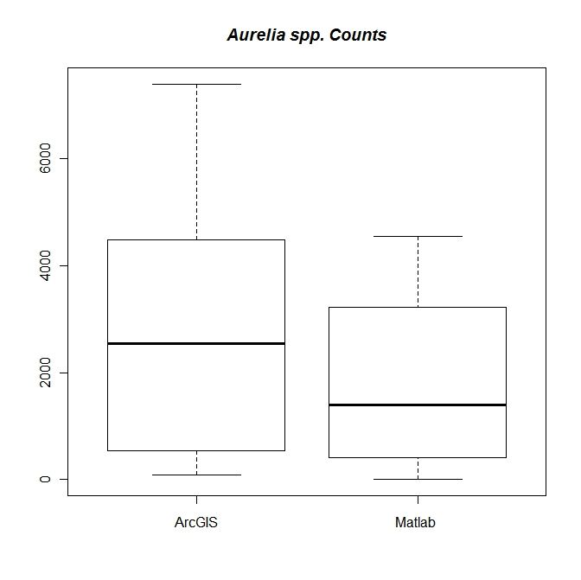
Moon Jelly
Results: Student’s T-Test
N=15
No statistical significance between the two methods
Notes:
On the x-axis is the ArcGIS manual count and on the Y-axis the automated matlab jelly count
If the automated program was perfect detecting every jelly in the photo we would see the 1-1 dotted line.
For our data the solid line we see that the algorithm underestimates especially when aggregations are high. This is due to the nature of the aggregations moon jellies tend to stack on top of each other so this hinders the algorithm’s ability to distinguish individual jellies based on surface area

Slide 31
Moon Jelly
Results: Student’s T-Test
N=15
Notes:
On the x-axis is the ArcGIS manual count and on the Y-axis the automated matlab jelly count
If the automated program was perfect detecting every jelly in the photo we would see the 1-1 dotted line.
For our data the solid line we see that the algorithm underestimates especially when aggregations are high. This is due to the nature of the aggregations moon jellies tend to stack on top of each other so this hinders the algorithm’s ability to distinguish individual jellies based on surface area

Slide 32
Conclusions
We saw no significant difference between the two methods.
The automated detection algorithm underestimates, but is not biologically significant
Can use the automated detection algorithm in replacement to manual count
Estimate the minimum number of surface jellies seen during a survey year relative to oceanographic conditions
Notes:
We found a significant , positive relationship between manual and automated estimates which indicates that the algorithm is a useful tool to calibrate observer estimates of surface swarms of jellies despite its slight downward bias for moderate to dense jelly aggregations.
The efficiency of the automated detection algorithm provides important and timely information for leatherback turtle prey studies and critical habitat assessments

Slide 33
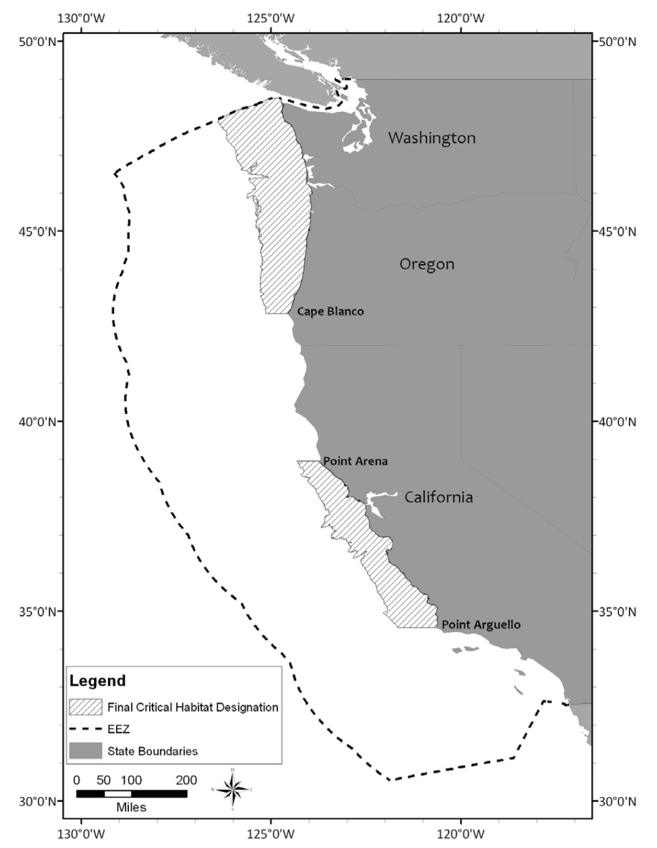
Management
Endangered Species Act
Add to existing methods
Monitor jelly populations for future years
Can calibrate observer estimates for past data
Build density maps
(NOAA Fisheries 2012)
Notes:
We found a significant , positive relationship between manual and automated estimates which indicates that the algorithm is a useful tool to calibrate observer estimates of surface swarms of jellies despite its slight downward bias for moderate to dense jelly aggregations.
The efficiency of the automated detection algorithm provides important and timely information for leatherback turtle prey studies and critical habitat assessments

Slide 34
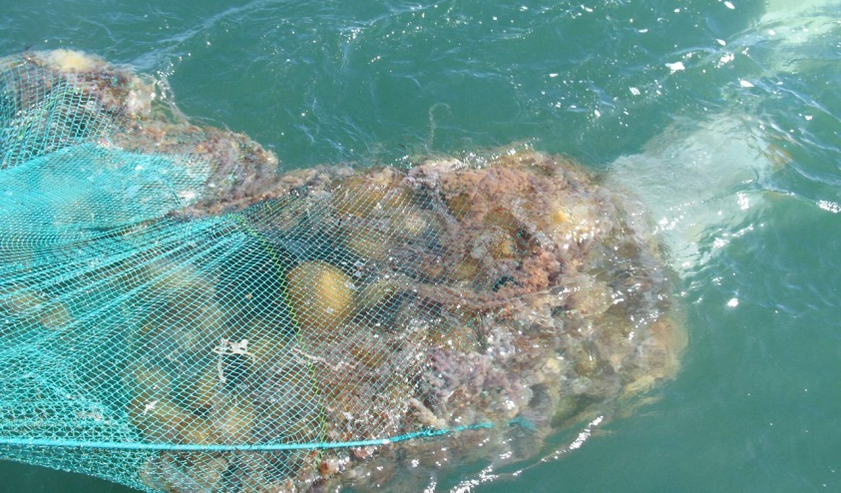
Future Work
Density maps
Track abundance annually
Hot spots
Prediction of leatherbacks in the future
Fishing nets
Sea water uptake valves
Notes:
I will be continuing to apply this method to the remaining photos from October 2010 and October 2011. The new estimates of the density categories will be able to help researchers understand the relative magnitude of jellies seen on a given survey year relative to oceanographic conditions and if there is a trend.
I will use the GPS data that was recorded during transects to build density maps. These maps that will allow us to see were turtles have been found in relation to the jelly aggregations. The maps will also be helpful in locating hot spots or high jelly density aggregations that may be detrimental to fishing efforts and sea water uptake valves. These hot spots can also be predictors of leatherbacks in the future.

Slide 35
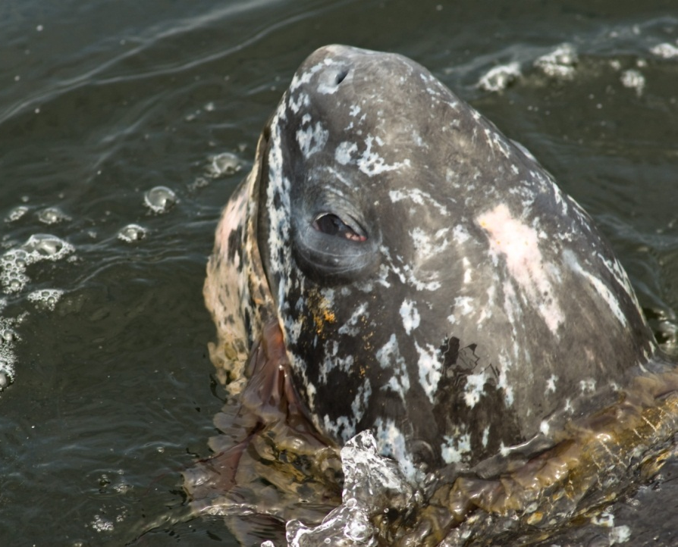
Acknowledgments
Special thanks to Barry Hansen, Aspen Helicopters, Inc., the NOAA Aerial Survey Team, and many others who made this project possible.
Aerial surveys were conducted under National Marine Fisheries Service permit 1596-02, and National Marine Sanctuary permit MULTI-2008-003.
Funding was provided by the Dr. Earl H. Myers and Ethel M. Myers Oceanographic and Marine Biology Trust and the National Science Foundation, Undergraduate Research Opportunities Center, CSUMB, Dr. William Head CSU-LSAMP Senior Alliance project, NSF grant no. HRD-0802628.
Photo :Scott Hanson
Notes:
I would like to thank the people involved in this project and my funding sources.
And if there is any time I will take questions.

Slide 36



New Photograph Categorization?
?
Low
(1-200)
Moderate
(201-1,000)
??
(1,001-5,000)
High
(>5,000)
Notes:
NOTE: this slide will only be used if some one asks me what I think about re-evaluate the categorizations during transects for observers.
Depends on the object of the study if we are conducting a leatherback abundance and distribution study then I do not think it is needed
On the other hand if we were conducting a jellyfish survey we would defiantly want to change the categorization method to record the difference between a large amount of jellies and the obscene amount.

